Slide 1


Astrosage Platform analysis
Saurav Kumar
01-05-2026

Slide 2



Introduction and Objective
About AstroSage -
Online astrology consultation platform connecting users with vetted astrologers (Gurus)
Modes: Chat and Call (primary), with occasional live/public sessions
Pay-per-minute model; platform commission + astrologer earnings

Slide 3
How it Works
How it works (user journey) 1) Discover: Browse astrologers by expertise, rating, availability, price
Choose mode: Select Chat or Call; view rate/min and language
Transact: Add funds and start session; timer tracks billable minutes
Consult: Real-time guidance; session status recorded (Completed/Failed/Incomplete/etc.)
Close: Amount settled; user can rate/review; insights feed quality monitoring

Slide 4
Data Overview
Scope and volume -
-Total sessions: 28,027
- Unique users: 10,344
- Unique astrologers (Gurus): 149
- Time window (analysis focus): Dec 2023 – Jan 2024
Key metrics
- Total revenue: ₹665,387.12
- Astrologer earnings (payouts): ₹309,051.00
- Average rating: 2.93
- Avg. daily volume: 246.0 sessions/day
Mix and distribution
- Consultation types: Chat 69.6% (19,514), Call 30.4% (8,508), others <0.1%
- Session outcomes: No Records 30.4%, Failed 25.9%, Incomplete 23.7%, Completed 19.7%
- Region: Others 67.8% (19,008), Indian 32.2% (9,019)

Slide 5
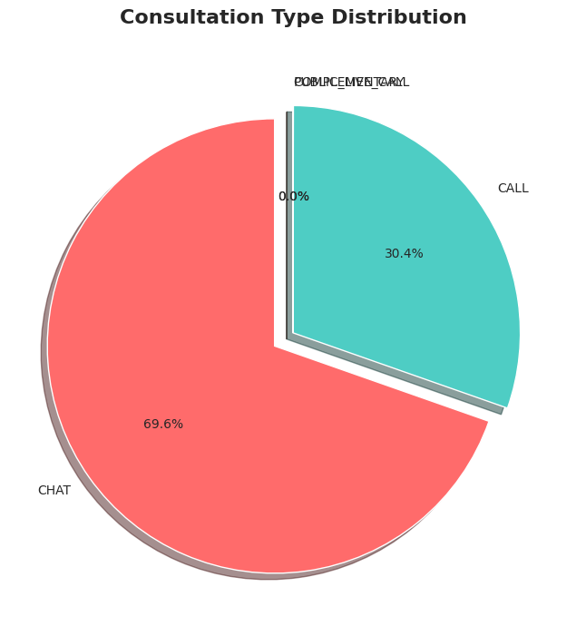
Consultation Type Distribution
30.4% - CALL
69.6% - CHAT
Channel performance - Preference: Chat leads volume (69.6%)
- Monetization: Calls generate higher revenue per session despite lower volume
- Revenue by type (total): Chat ≈ ₹376.7K; Call ≈ ₹288.6K

Slide 6
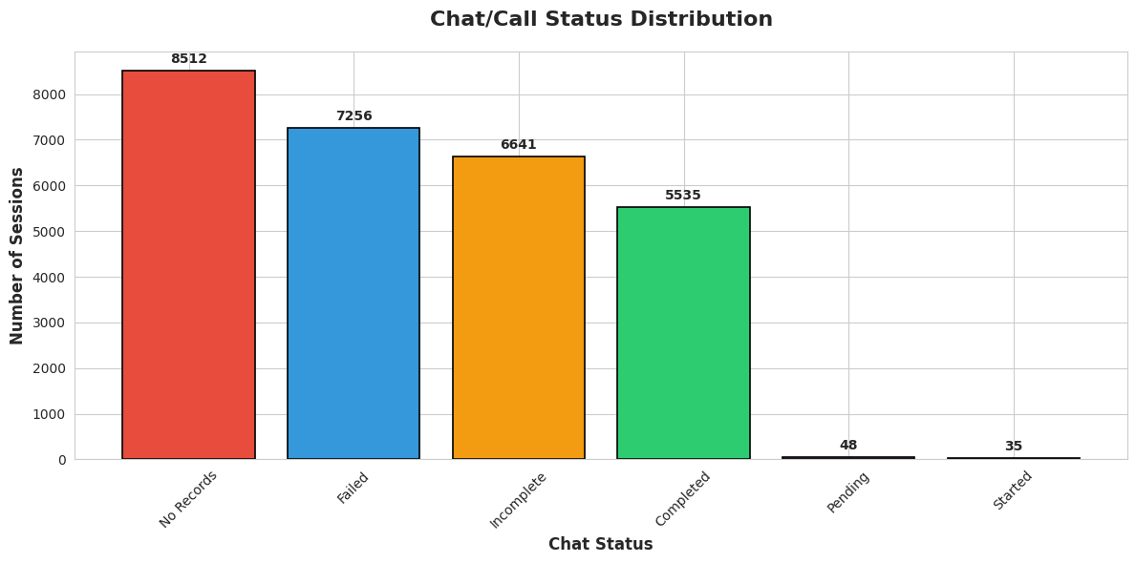
Call Distribution Status
Cleaned Datasheet records shows that
- 8512 – no records for call
- 7526 – failed
- 6641- Incomplete
- 5535 – completed
- 48 – Pending
35 – Started

Slide 7
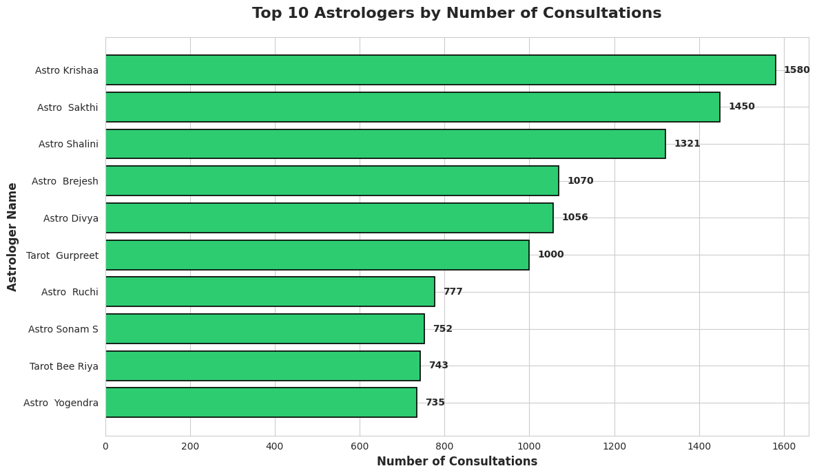
Top 10 Astrologer by Number of consultant

Slide 8
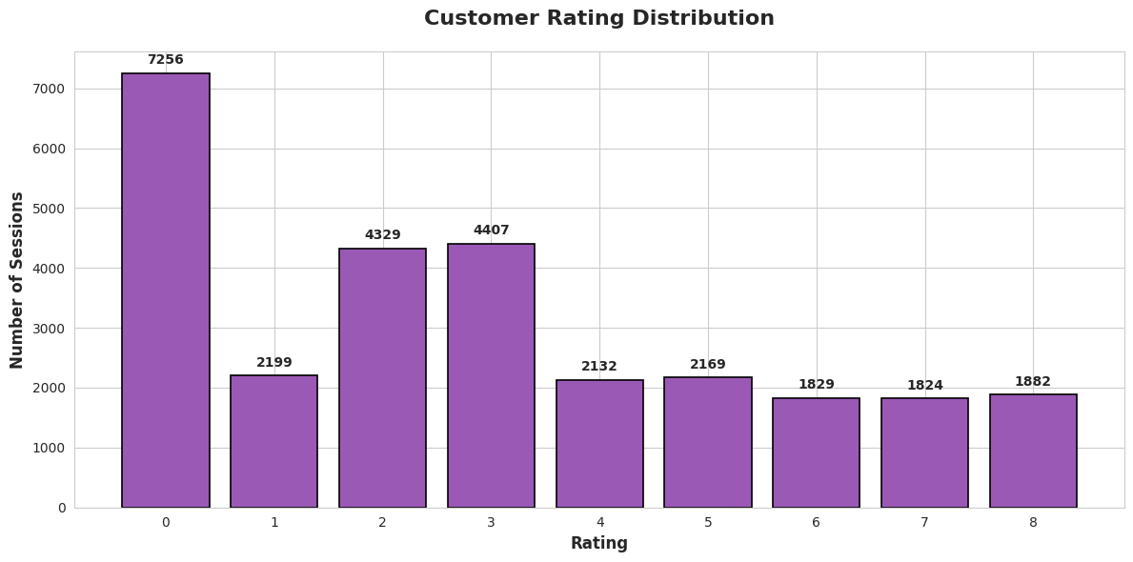
Customer rating Distribution
Customer satisfaction is moderate → needs improvement- So majority of the customer rating are lying to zero, An exceptionally dwindling number are towards high rating.

Slide 9
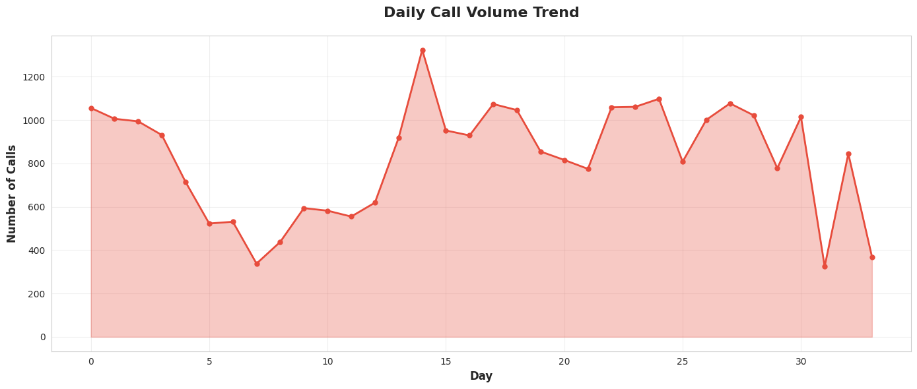
Daily Call Volume Trend

Slide 10
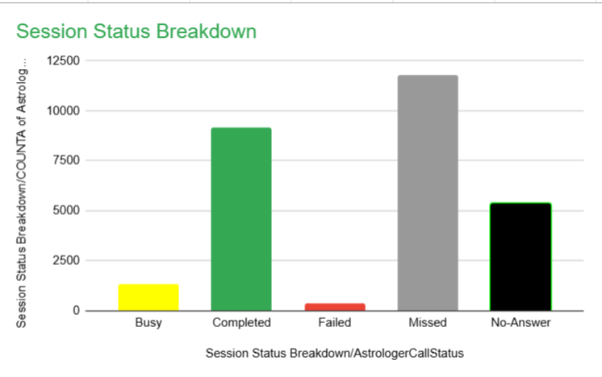
Call Status
Based on the records it shows that majority of the call are showing as missed
Busy- 4.79%
Completed-32.73%
Failed- 1.37%
Missed-41.99% No Answer- 19.15 %

Slide 11
Conclusion
If You have invest 1 cr rupee to optimizer the operational efficiency and enhance customer satisfaction, based on the data, i would invest more in training program and quality improvement rather than other areas
Prioritize training to improve customer satisfaction
Use data-driven hiring for peak periods
Implement automation tools to reduce workload
Balance workload across agents
Continuously monitor KPIs using dashboards

